Slide 1
Styling
<h1 style="color:blue;">This is a heading</h1>
<p style="color:red;">This is a paragraph.</p>
<h1 style="background-color:red">PGDAC</h1>
<h1 style="border:2px solid red">Hello World</h1>

Slide 2
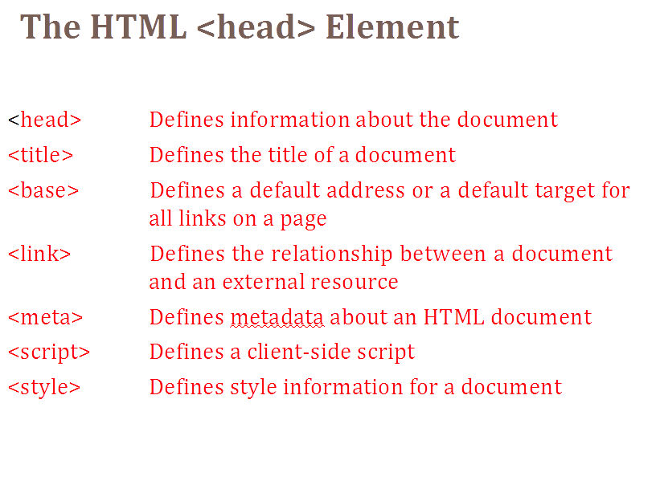

Slide 3
<Doctype>
<!DOCTYPE html>
Note The <!DOCTYPE> declaration must be the very first thing in your HTML document, before the <html> tag.
it is an instruction to the web browser about what version of HTML the page is written in.

Slide 4
Hr (horizontal line)
<hr width=50% align=left color="red">

Slide 5
1. Character Encoding
Defines which character set the page uses.
<meta charset="UTF-8">
Viewport (Responsive Design)
Controls how the page is displayed on mobile devices.
<meta name="viewport" content="width=device-width, initial-scale=1.0">
width=device-width → fits page to device screen.
initial-scale=1.0 → sets zoom level.

Slide 6
Page Description
Gives a short summary for search engines (SEO)
<meta name="description" content="Learn HTML metadata options with examples.">
<meta name="keywords" content="HTML, meta tags, SEO, metadata">
<meta name="author" content="Anu Mehra">
<meta http-equiv="refresh" content="30"> <!-- refresh every 30s -->

Slide 7
What is SEO?
(Search Engine Optimization)
SEO is the process of improving a website so that it ranks higher in search engine results (like Google, Bing).
Higher ranking → More visibility → More visitors.

Slide 8
<base>
Specify a default URL and a default target for all links on a page:
<head> <base href="https://india.gov.in/my-government/" target="_blank"> </head> <body> <a href="government-directory" >Directory</a>

Slide 9
<meta>
The <meta> tag provides metadata about the HTML document. Metadata will not be displayed on the page, but will be machine parsable.
Meta elements are typically used to specify page description, keywords, author of the document, last modified, and other metadata.

Slide 10
The metadata can be used by browsers (how to display content or reload page), search engines (keywords), or other web services.
Metadata is always passed as name/value pairs.

Slide 11
Example
<meta name="keywords" content="HTML, CSS, XML, XHTML, JavaScript">
<meta name="description" content=“my web page ">

Slide 12
Refresh page after 30 second
<meta http-equiv="refresh" content="30">

Slide 13
Setting the viewport to make your website look good on all devices:
<meta name="viewport" content="width=device-width,
initial-scale=1.0">

Slide 14
Html Listing

Slide 15
1) Ordered list
2) Un ordered list
3) definition list

Slide 16
Unordered list
----------------Example 1-----------------
<ul>
<li>noida</li> <li>delhi</li> <li>pune</li> </ul>
---------------Example 2-------------
<ul style="list-style-type:none"> <li>noida</li> <li>delhi</li> <li>pune</li> </ul>

Slide 17
Value | Description
disc | Sets the list item marker to a bullet (default)
circle | Sets the list item marker to a circle
square | Sets the list item marker to a square
none | The list items will not be marked

Slide 18
OrderedList
<ol>
<li>noida</li> <li>delhi</li> <li>pune</li> </ol>

Slide 19
Type | Description
type="1" | The list items will be numbered with numbers (default)
type="A" | The list items will be numbered with uppercase letters
type="a" | The list items will be numbered with lowercase letters
type="I" | The list items will be numbered with uppercase roman numbers
type="i" | The list items will be numbered with lowercase roman numbers

Slide 20
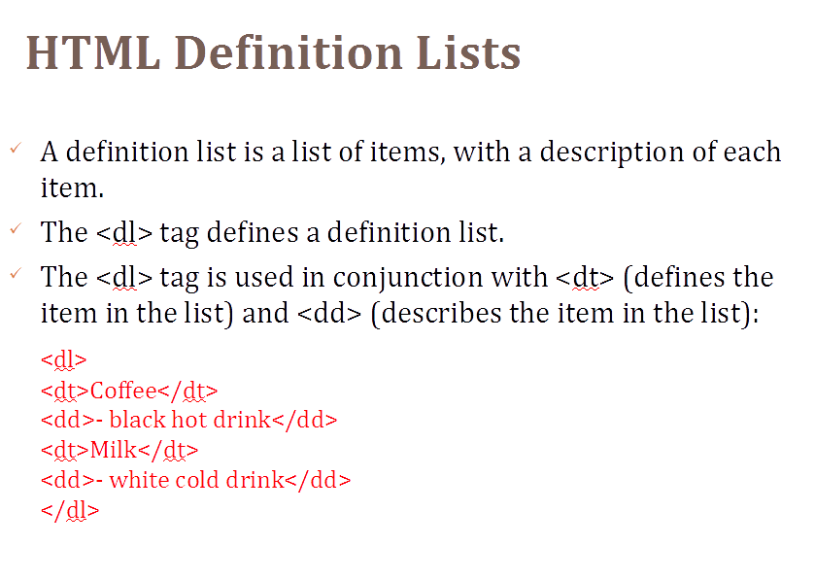

Slide 21
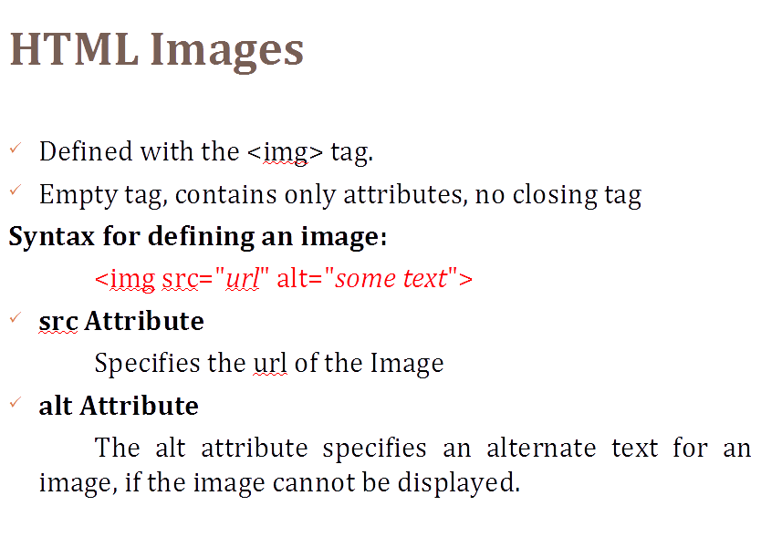

Slide 22
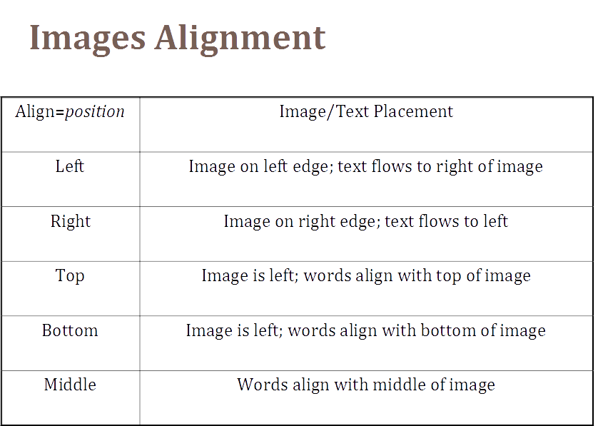

Slide 23
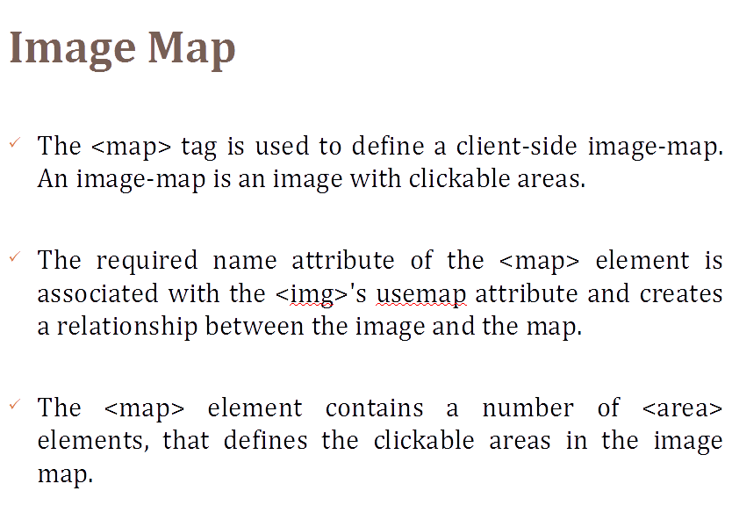

Slide 24
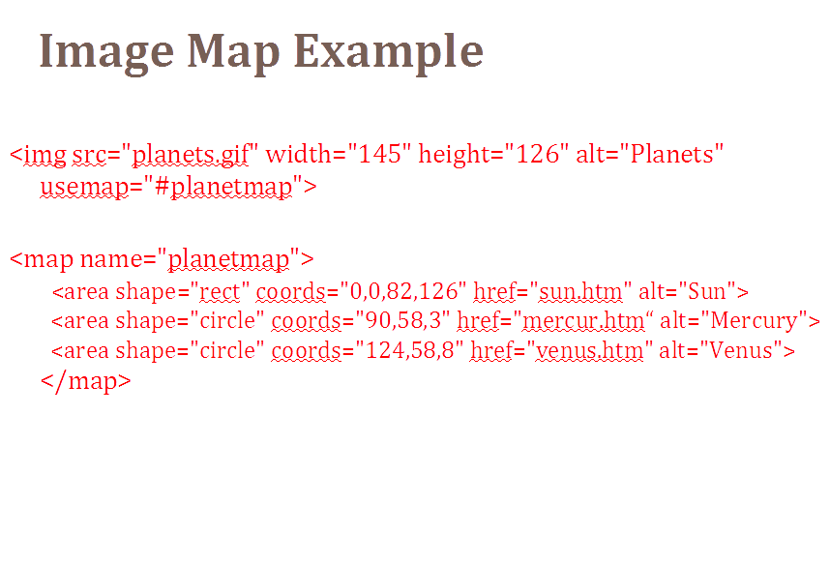

Slide 25
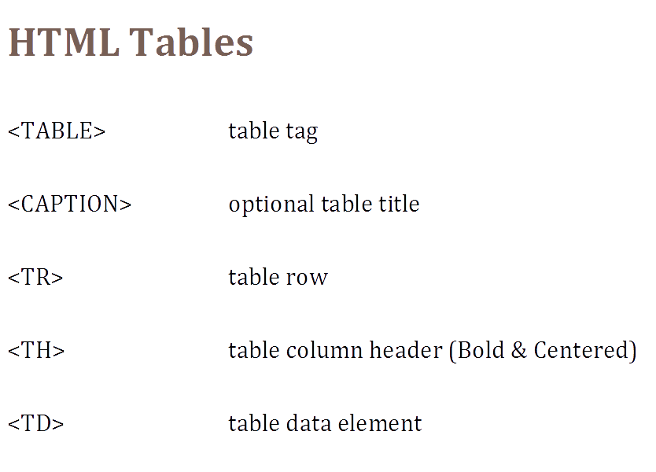

Slide 26
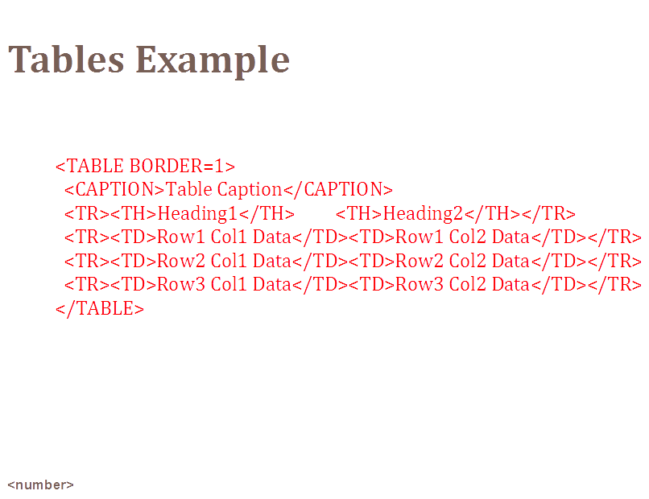

Slide 27
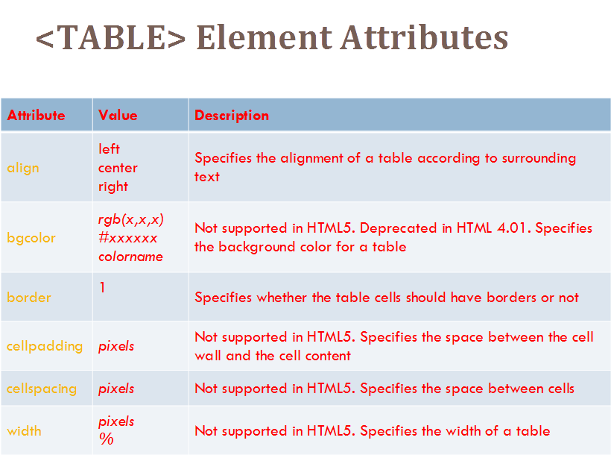

Slide 28
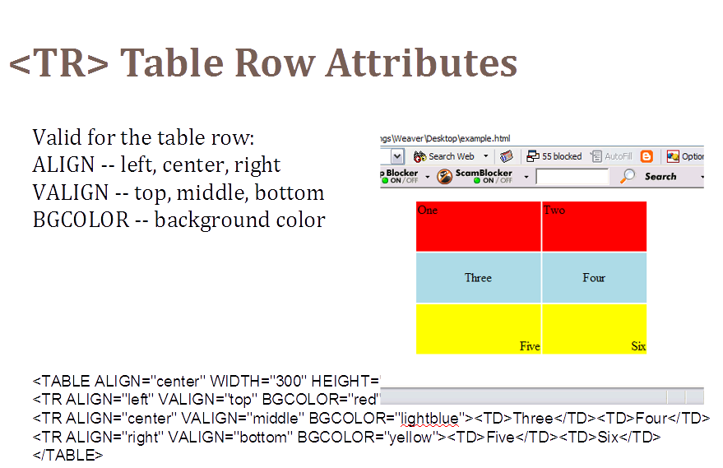

Slide 29
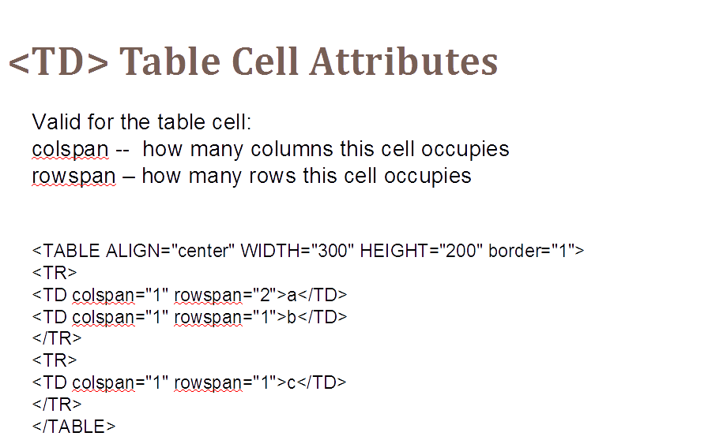

Slide 30
table { border-collapse: separate; border-spacing: 5px; }
/* cellspacing="5" */

Slide 31
<table style="width:100%"> <caption>heading for table </caption> <tr> <th></th> <th></th> </tr> <tr> <td></td> <td></td> </tr> </table>

Slide 32
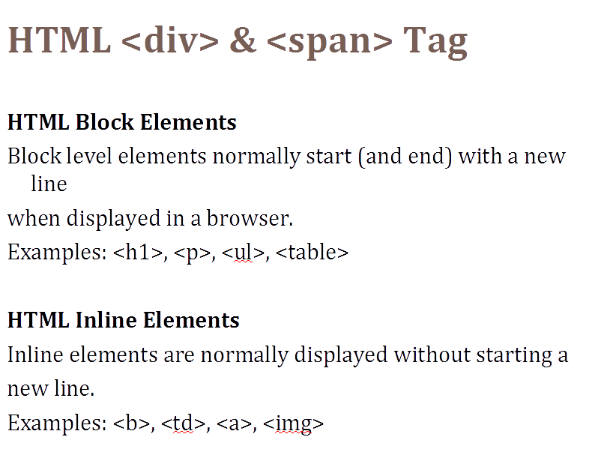

Slide 33
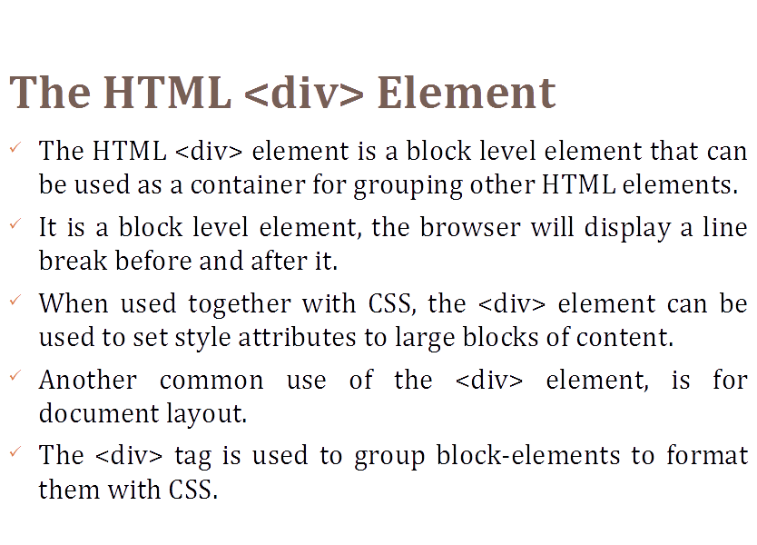

Slide 34
Example
<div style="background-color:black;color:white;padding:20px;">
<h2>PGDAC</h2>
<p>…………………………..</p>
<p>***************</p>
</div>

Slide 35
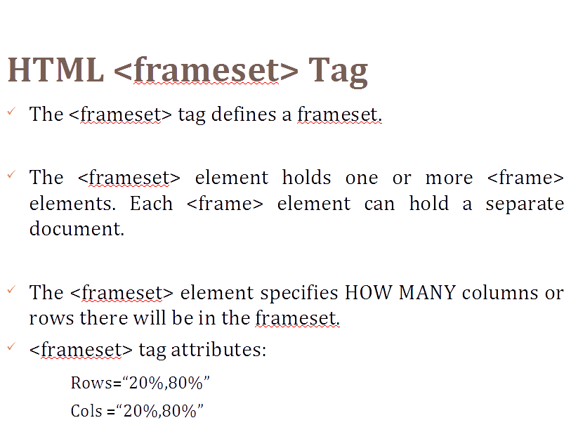

Slide 36
Example
<html> <frameset cols="25%,50%,25%"> <frame src="frame_a.htm"> <frame src="frame_b.htm"> <frame src="frame_c.htm"> </frameset> </html>

Slide 37
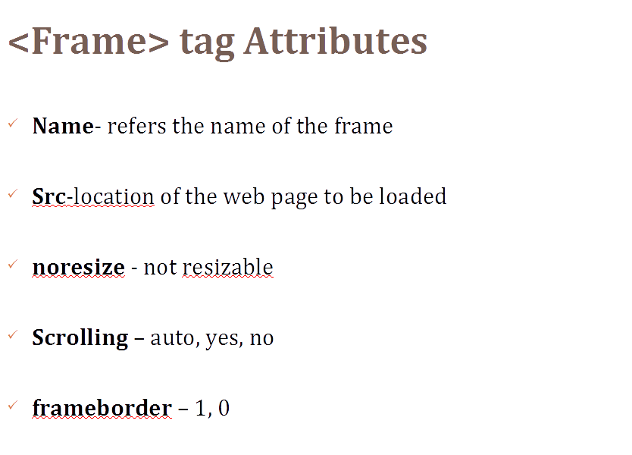

Slide 38
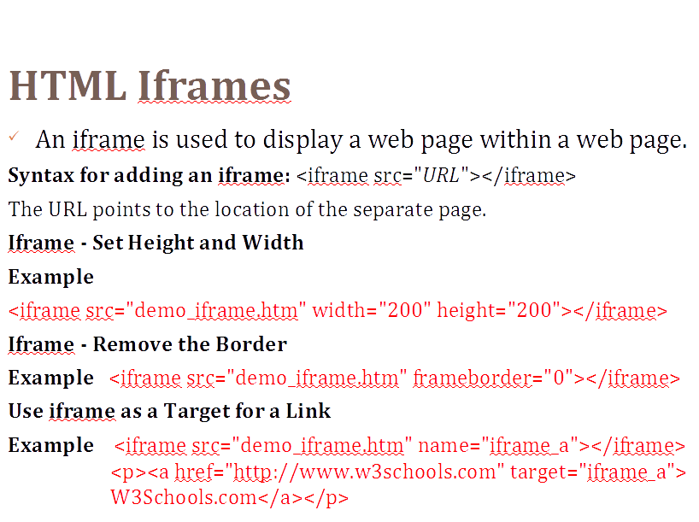

Slide 39
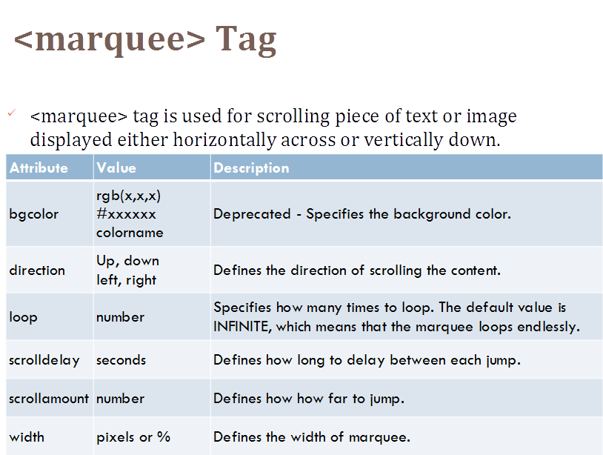

Slide 40
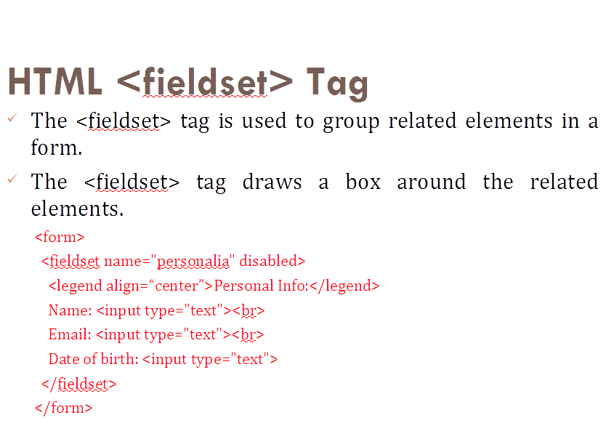

Slide 41
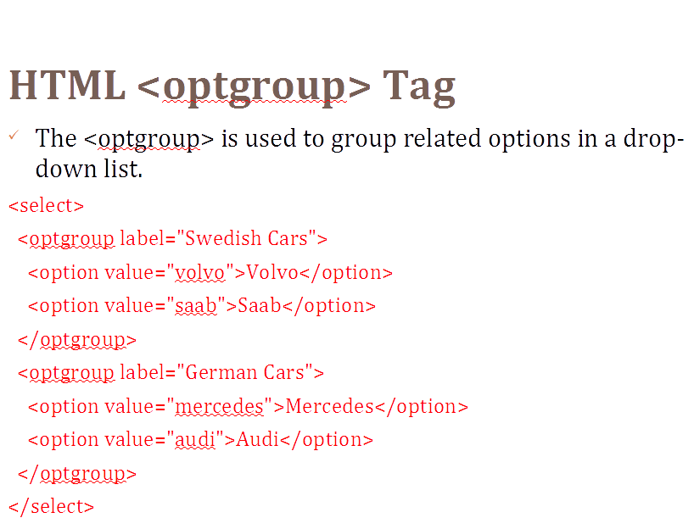

Slide 42
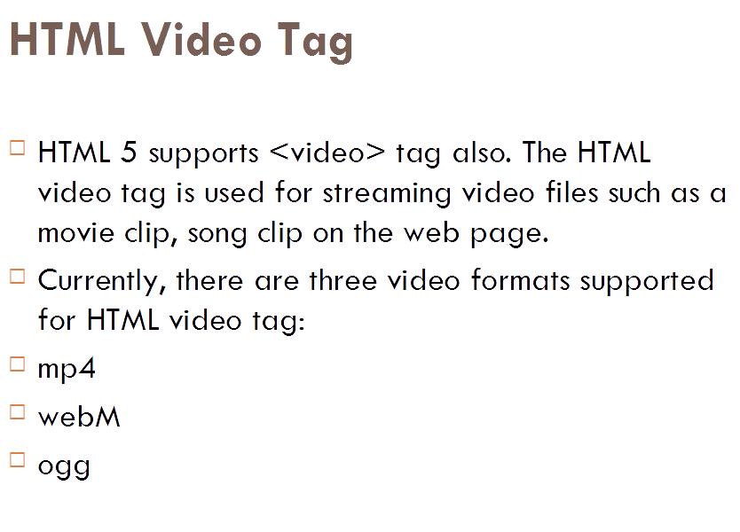

Slide 43
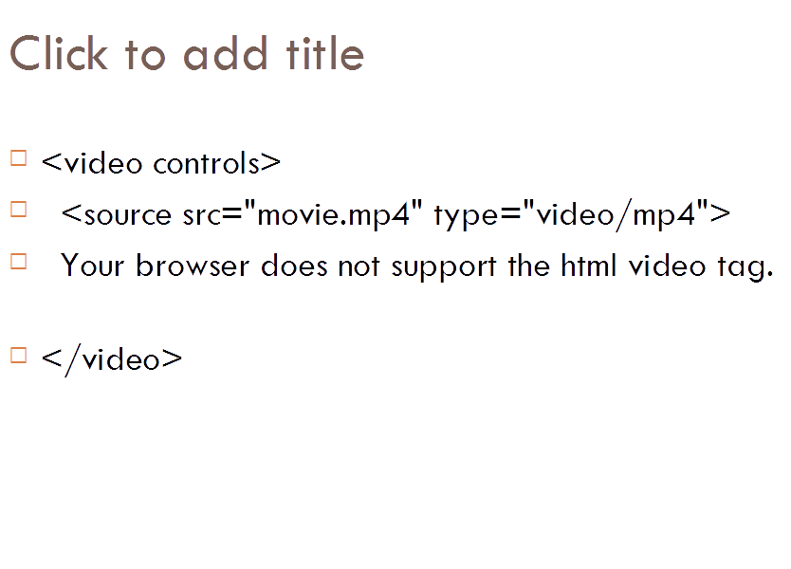

Slide 44
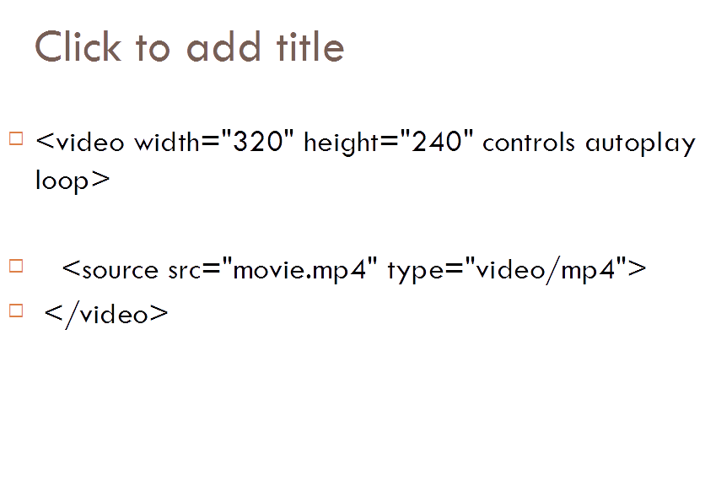

Slide 45
Image uploading

Slide 46
